Slide 1
Problem:
Overcharging in the market for dental procedures

Slide 2
There is a lack of price transparency for dental procedures.
This prevents healthy competition between dentists.

Slide 3
Research shows affordability, and perception of affordability, lowers dentist visit rates.
Dentists themselves acknowledge that overcharging is an issue.

Slide 4
Why isn’t this problem solved already?
Dentists have no incentive to publish pricing information to the public.
Existing doctor review services don’t work

Slide 5
Our solution: Glassdoor for dental costs.
Open sharing of dental procedure costs.

Slide 6
Glassdoor allows anonymous sharing of salary information by company and job title.
We allow anonymous sharing of dental procedure costs via verified receipts.

Slide 7
The dentist receipt has all the information we need.
Adds credibility to the the information.

Slide 8
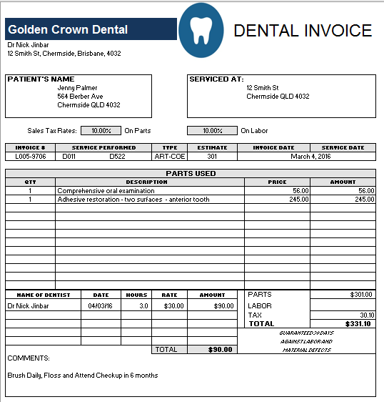

Slide 9
Use case:
I have been to the dentist. Have I been overcharged?

Slide 10
Use case:
I need to find a dentist. What are the prices like at the dentists around me?

Slide 11
How does our solution solve the problem?
Open pricing puts pressure on dentists to charge fairly.

Slide 12
Open pricing doesn’t punish dentists:
Research shows price transparency encourages competition on service quality.

Slide 13
Our solution scales to other markets where there is a lack of price transparency.
Other medical services, mechanics, lawyers.

Slide 14
This was a real team effort. Team formed Saturday.
We narrowed down the problem, worked together to execute the solution

Slide 15
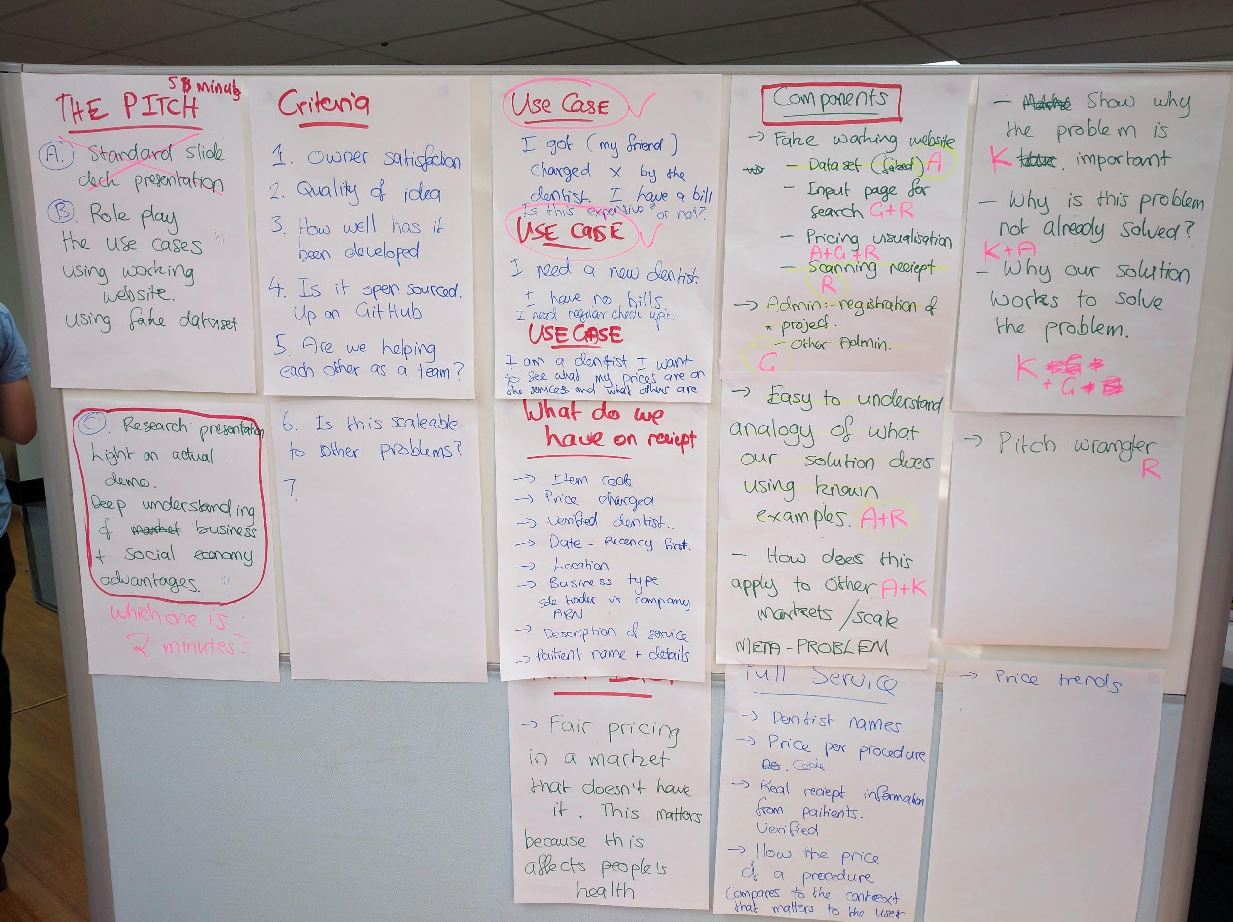

Slide 16
We have all learnt a lot about how the dental market works.
Special thanks to Michael Foley!
We now know that gold crowns are no.1

